Slide 1
Housing Price Prediction Model
Submitted By- Rakesh Shinde

Slide 2
Introduction
Houses are one of the necessary needs of each and every person around the globe and therefore housing and real estate market is one of the markets which is one of the major contributors in the world’s economy. It is a very large market and there are various companies working in the domain.
Data science comes as a very important tool to solve problems in the domain to help the companies increase their overall revenue, profits, improving their marketing strategies and focusing on changing trends in house sales and purchases. Predictive modelling, Market mix modelling, recommendation systems are some of the machine learning techniques used for achieving the business goals for housing companies.
Our problem is related to one such housing company.

Slide 3
Problem Statement
A US-based housing company named Surprise Housing has decided to enter the Australian market. The company uses data analytics to purchase houses at a price below their actual values and flip them at a higher price. For the same purpose, the company has collected a data set from the sale of houses in Australia. The data is provided in the CSV file below.
The company is looking at prospective properties to buy houses to enter the market. You are required to build a model using Machine Learning in order to predict the actual value of the prospective properties and decide whether to invest in them or not. For this company wants to know:
• Which variables are important to predict the price of variable?
• How do these variables describe the price of the house?

Slide 4
Business Goal
It is required to model the price of houses with the available independent variables.
This model will then be used by the management to understand how exactly the prices vary with the variables. They can accordingly manipulate the strategy of the firm and concentrate on areas that will yield high returns.
Further, the model will be a good way for the management to understand the pricing dynamics of a new market.

Slide 5
Understanding the Dataset
Train Data set is having 1168 rows and 81 columns including the target column
Test Dataset is having 292 row and 80 columns
Checked data for null values present in multiple columns it has to taken care for the either treating it and dropping the column.
For PoolQC, MiscFeature, Alley, Fence, FireplaceQu the Null values are either equal to 50% or more than that so we can think of dropping that columns

Slide 6
Filling null values
The columns having less than 20% data as null are being filled by its mean and mode depending on the type of column

Slide 7
Describe Function
1. MSSubClass, LotArea, OverallQual, OverallCond, BsmtFinSF1, OpenPorchSF, MoSold are positively skewed as mean is more than median
2. LotFrantage is normally distributed
3. Rest is having some complex distribution can be seen from the Histogram

Slide 8
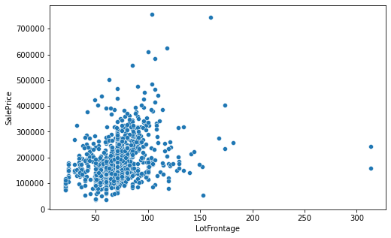
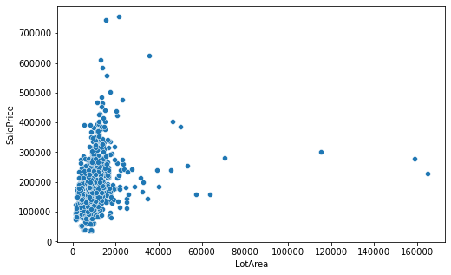
Visualization
As LotFrontage area has increased the Sale price is also increased
For LotArea 0 to 20000 the price might have increased because of other important factors

Slide 9
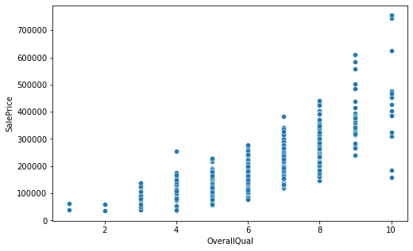
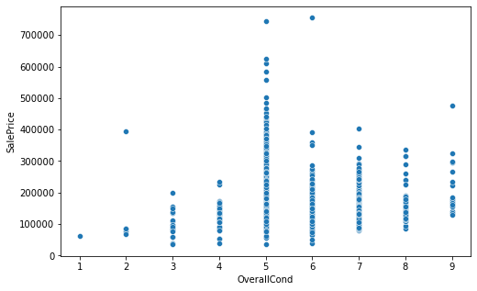
Visualization
As Overall Quality increased the Sale price is also increased.
As Overall Condition is good the Sale price is high.

Slide 10
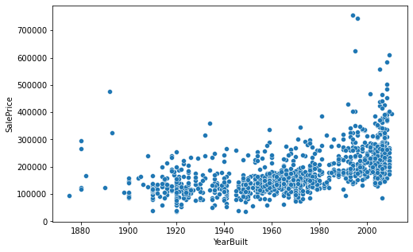
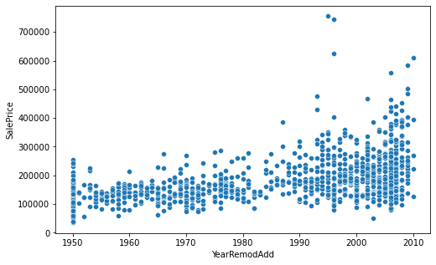
Visualization
Year of built is older, then Sale price is lower and for recent built price has increased
If year of Remodification is recent one then the price is on higher side

Slide 11
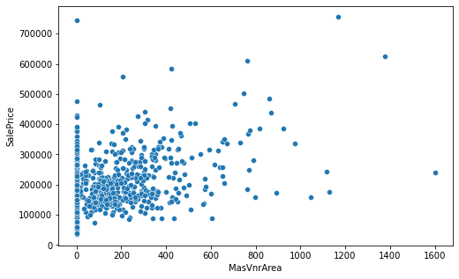
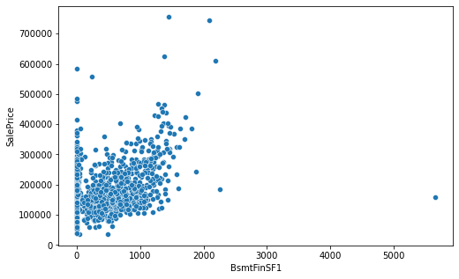
Visualization
Masonry veneer area increases the Sale price has increased
Type 1 finished increases the Sale price has also increased

Slide 12
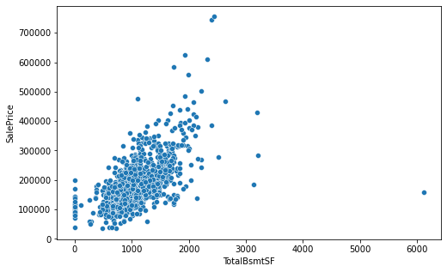
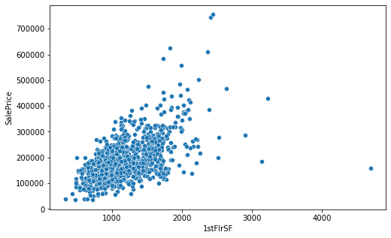
Visualization
As Total Basement Area Increases the Sales price has increased
As first Floor Area increased the Sale price have increased

Slide 13
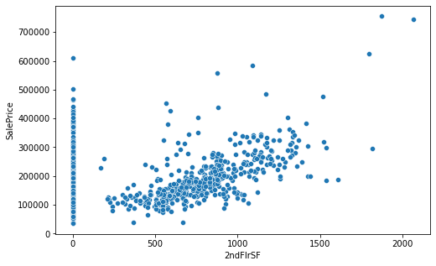
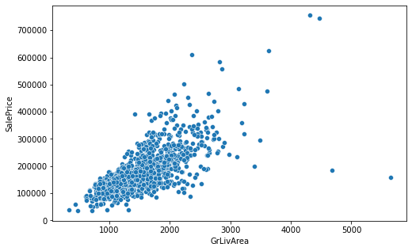
Visualization
As second Floor Area increased the Sale price have increased
Increase in trend for ground living area is seen

Slide 14
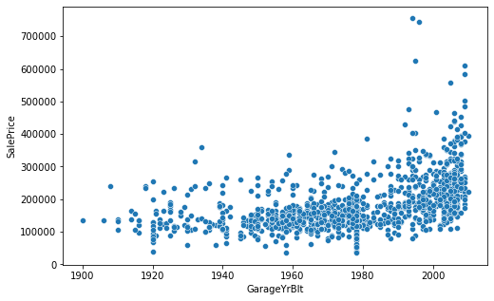
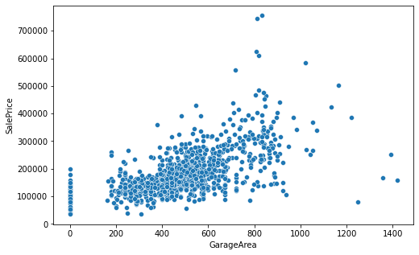
Visualization
As the garage-built year is recent the sale price is higher
As Garage area increased the sale price has also increased

Slide 15
Correlation

Slide 16
Important Factors Affecting the sale price
The following factors are more important and positively correlated with the Sale Price (The pearson correlation coefficient is shown against every factor which is important the range is varying if the coefficient is between 0.8 to 0.6 then it is having strong relationship with target variable, and then if it is between 0.6 to 0.4 moderate correlation exits, and less than that up to 0.1 very low correlation is said to be exists.
OverallQual 0.789185
GrLivArea 0.707300
GarageCars 0.628329
GarageArea 0.619000
TotalBsmtSF 0.595042
1stFlrSF 0.587642
FullBath 0.554988
TotRmsAbvGrd 0.528363
YearBuilt 0.514408
YearRemodAdd 0.507831
MasVnrArea 0.463626
Fireplaces 0.459611
GarageYrBlt 0.458007
Foundation 0.374169
BsmtFinSF1 0.362874
OpenPorchSF 0.339500
2ndFlrSF 0.330386
LotFrontage 0.323779
WoodDeckSF 0.315444
HalfBath 0.295592
GarageType -0.299470
HeatingQC -0.406604
GarageFinish -0.537121
KitchenQual -0.592468
ExterQual -0.624820
BsmtQual -0.626850

Slide 17
Dropping the columns
From train database the following columns are dropped because of their very low correlation with the target variable and very high Null values present in the database
[,'Id','PoolQC', 'MiscFeature', 'Alley', 'Fence', 'FireplaceQu', 'MiscVal', 'PoolArea', 'Condition2', 'Utilities', 'Exterior2nd', 'GarageQual', 'MoSold', '3SsnPorch', 'BsmtCond', 'Street', 'Condition2', 'LandContour', 'BsmtFinType2', 'LandSlope', 'MasVnrType', 'BsmtFinSF2', 'BsmtHalfBath', 'MiscVal', 'LowQualFinSF', 'YrSold', 'SaleType', 'LotConfig', 'MSSubClass', 'OverallCond', 'BldgType', 'BsmtFinType1', 'Heating']

Slide 18
Conversion of Categorical Data
The Categorical data is converted into codes by the Label Encoder

Slide 19
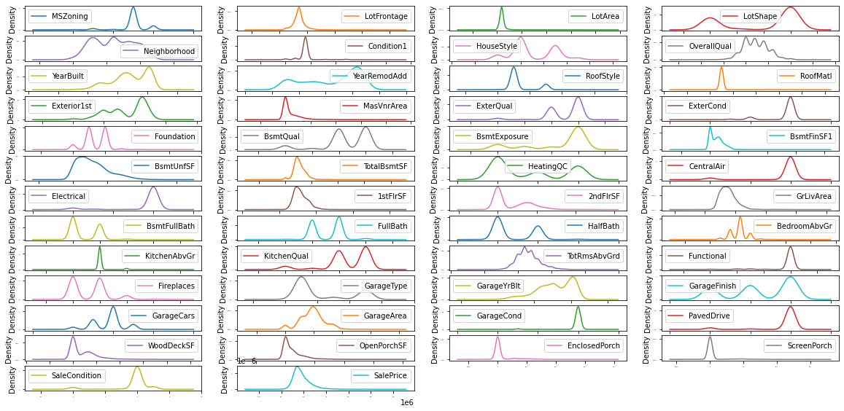
Skewness of the data

Slide 20
Skewness of the data
From plotting the Distribution plot we can see that there are multiple columns are having the skewness and to be treated
The Highly skewed columns are dropped and then some are treated with Power transform method

Slide 21
Checking for Outliers
The outliers are checked with zscore, it is observed that many continuous columns are having skewness and it is to detected
It is observed that 39% data in outliers and cannot be removed it is mainly because of two reasons
The data collection strategy is wrong
The data is real and will add some important value to the model
Hence, I have decided to keep the outliers as I am not having the domain knowledge of real estate. To check whether outlier is really a outlier or some important data point.

Slide 22
Training the Train dataset
As the target variable is continuous this dataset will go with regression type of supervised learning approach
The Best random state with Linear Regression is found out to be 94, following are the Algorithms are used and Cross val Scores are also evaluated.

Slide 23
Results of various Algorithms

Slide 24
Discussion on results of various algorithms
I have tabulated the outcomes for all the algorithms
The Gradient Boosting Regressor is giving a good training and testing accuracy with minimum difference in it, also we can see that the Root mean squared error is also less than the others
The cross val score of for the Gradient Boosting Algorithm also supports the testing score that data is not overfitted.

Slide 25
Hyperparameter Tuning
The Hyper parameter tuning is done on Gradient boosting to see the best optimal set of the parameters listed
{'criterion': 'friedman_mse', 'learning_rate': 0.1, 'max_features': 'log2', 'max_leaf_nodes': 10 'n_estimators': 200}
The Testing score is observed to same as that earlier tabulation

Slide 26
Conclusion
Following are the factors which are very important in descending order
OverallQual 0.789185
GrLivArea 0.707300
GarageCars 0.628329
GarageArea 0.619000
TotalBsmtSF 0.595042
1stFlrSF 0.587642
FullBath 0.554988
TotRmsAbvGrd 0.528363
YearBuilt 0.514408
YearRemodAdd 0.507831
MasVnrArea 0.463626
Fireplaces 0.459611
GarageYrBlt 0.458007
Foundation 0.374169
BsmtFinSF1 0.362874
HeatingQC -0.406604
GarageFinish -0.537121
KitchenQual -0.592468
ExterQual -0.624820
BsmtQual -0.626850

Slide 27
Conclusion
Gradient Boosting Model is well predicting the Sale Price of the houses with 90.67% accuracy
It is well suited for the data
As the domain knowledge of the data is not there hence multiple columns are dropped.
But it is dropped on statistical evidences as that are not correlated, having very high null values and very high skewness
The test data is also went through same procedure as train data set has gone and predicted the sale price for the tests data.

